Slide 1

Smart Attendance Using Face Recognition
Submitted in partial fulfilment for the award of the degree of
Bachelor of Technology
in
ELECTRONICS AND COMMUNICATION ENGINEERING
Submitted by:
18BTREC010 | Bhavana.L
18BTREC018 | Eakila Ajith Bhargav
18BTREC019 | G Sai Dharani
8BTREC046 | N Lohithas Reddy
Batch No. Batch 2018-22/AY 2021-22/B2
Date of Presentation: 22/06/2022
Dr. R. Sukumar
HOD
Department of Electronics and Communication Engineering
Faculty of Engineering and Technology
JAIN DEEMED-TO-BE UNIVERSITY

Slide 2

Content
Introduction
Literature Survey/Review
Problem Statement
Objectives
Design and Development-Software /Hardware
Methodology
Result Analysis in Real Time Hardware Demo / Simulation
Limitation and Applications
Conclusion and Future Scope
References

Slide 3
Introduction
During this era of technology and automation we are still using the same old ways of attendance
management.
The most important thing in the classroom/office is attendance which is directly linked to the
academic performance of the students/employees
In the past we were using techniques like roll numbering calling and signing against a particular
roll number. These methods carry a high chance of proxy and are time consuming
We came across are the idea of automating this process through modern day technologies to get
a well maintained and disciplined attendance,
Facial recognition systems along with suitable hardware and software will help meet the goals of
this project.
That information from image processing will play a great role and help in various walks of life where it could be implemented.
Our facial structure was a typical example of a multidimensional structure and needed some recognition from advanced computational analysis.

Slide 4
Introduction
The applications of image processing are vast and can be applied in most scenarios where imaging data could be related to pre-determined algorithms. It was an advanced application of image processing and also is the core basis for our project. Our facial structure was a typical example of a multidimensional structure and needed some recognition from advanced computational analysis.
Our core focus will be on receiving digital Images and then making use of programs and algorithms to get useful Information out of it. As the pictorial information is for the image processing work on it and make it human interpretation. That information from image processing will play a great role and help in various walks of life where it could be implemented.

Slide 5
Literature Review
IEEE Publication research papers are used as primary sources
Paper Name | Author(s) | Published year | Summary | Comments
Human Face Detection Techniques | Md Khaled Hasan, Md. Shamim Ahsan, Abdullah-Al-Mamun, S. H. Shah Newaz. | 2021 | In this paper an extensive survey on face detection methods, dividing them mainly on feature based and image based approaches | very high performing algorithms and the newest in face detection technology
A Review Paper on Face Recognition Methodologies | Raghuveer Bohara , Gourav Joshi , Hitesh Joshi , Ojas Ingale, Anand Bhosale. | 2020 | This paper revived on different methodologies And different approaches for face recognition. | Uses various practical methods and approaches to achieve Face recognition system
Study of Face Recognition Techniques | Madan Lal, Kamlesh Kumar, Rafaqat Hussain Arain, Abdullah Maitlo | 2018 | In this paper, a comprehensive study was performed over different face recognition methods | Developed face recognition techniques could be analyzed over varying facial expression

Slide 6
Problem Statement
The accuracy of the data collected is the biggest issue.
The instructor and training manager still have to do some work manually.
It cannot repeat live video to recognize missed faces.

Slide 7
Objectives
To develop a portable Smart Attendance System which is handy and self-powered.
Have enough memory space to store the database.
Able to recognize the face of an individual accurately based on the face database.
Allow new students or staff to store their faces in the database.
Able to show an indication to the user whether the face- recognition process is successful or not.
The objective of face recognition is, from the incoming image, to find a series of data of the same face in a set of training images in a database. The great difficulty is ensuring that this process is carried out in real-time, something that is not available to all biometric facial recognition software providers.

Slide 8
Objectives
Provides a valuable attendance service for both teachers and students.
Reduce manual process errors by provide automated and a reliable attendance system uses face recognition technology.
Increase privacy and security which student cannot presenting himself or his friend while they are not.
Detection of unique face image amidst the other natural components such as walls, backgrounds etc
Extraction of unique characteristic features of a face useful for face recognition.
Detection of faces amongst other face characters such as beard, spectacles etc.
Effective recognition of unique faces in a crowd(individual recognition in crowd).
Automated update in the database without human intervention

Slide 9
Design and development-Software/Hardware
Software:
1.Matlab(R2022a version)
Hardware:
1.Camera.
2.Laptop.
3.Storage.

Slide 10
Testing Technologies used
The proposed plan for An Automatic Attendance System using image processing includes:
1.Enrolment of faces .
2.Capturing the video of students.
3.Face detection and feature extraction.
4.Face recognition and marking attendance

Slide 11
Methodology
A. Enrollment Phase
1)Image Acquisition: For Image acquisition, camera is used to capture an image of the employees working in an organization.
2) Face Detection and Face cropping: For face detection cascading algorithm is used. Further face cropping is done using imcrop (image) command that separates the facial area from the rest of the background image. This faces is stored in the database.
3) Feature Extraction: Feature extraction is done by using linear binary pattern algorithm. Feature extraction is helpful for face detection and recognition.
4) Database: Extracted features of employees or persons will be stored in Database.

Slide 12
Methodology
B. Routine Attendance after Enrollment Phase
Routine attendance will start after extracting the features of all the images stored in the database. We have followed the same steps as given in enrollment phase i.e. image acquisition, Face detection, and face cropping.
Face recognition is done by using the Local binary pattern by taking 3x3 block a time and comparing central block with surrounding blocks and compare with features stored in the database. If after face recognition face of the person is matched in the database then update the attendance otherwise show the dialogbox with invalid person.

Slide 13
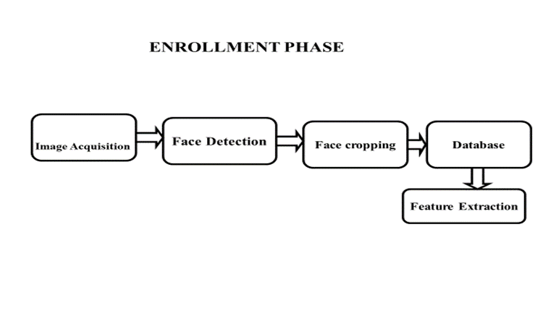
Methodology

Slide 14
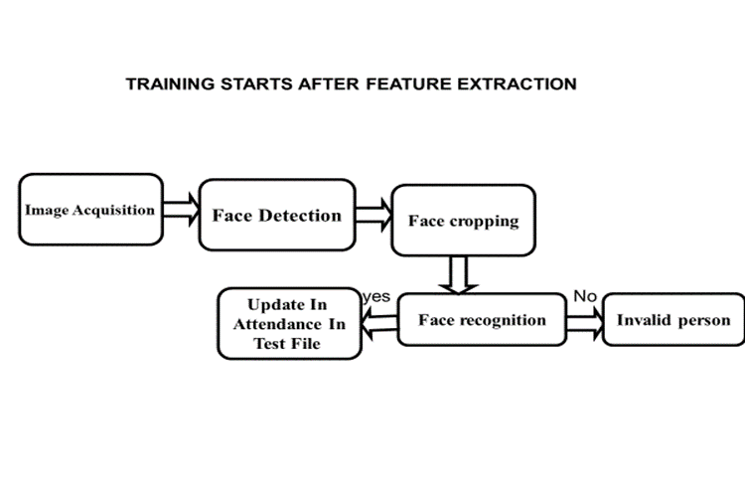
Methodology

Slide 15
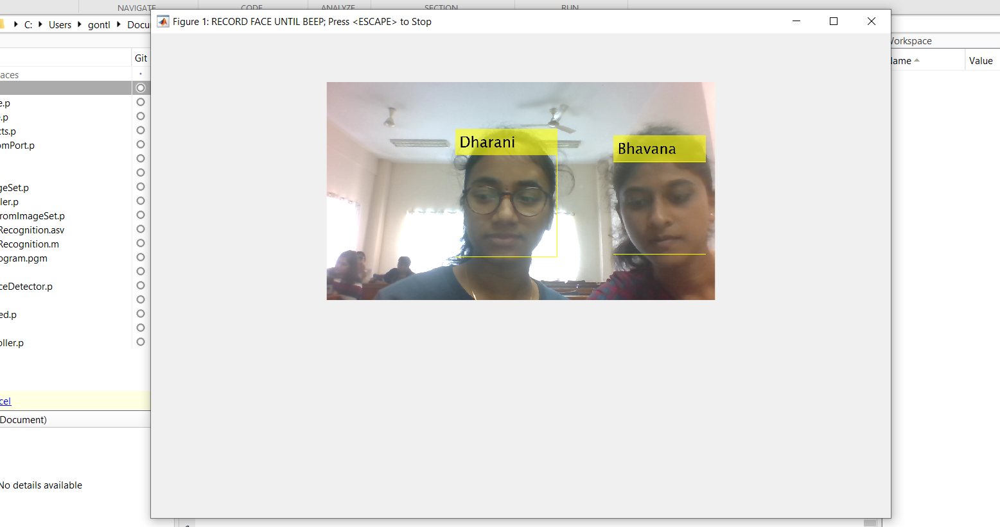
Result Analysis in real time
Faces are recognized through the camera.

Slide 16
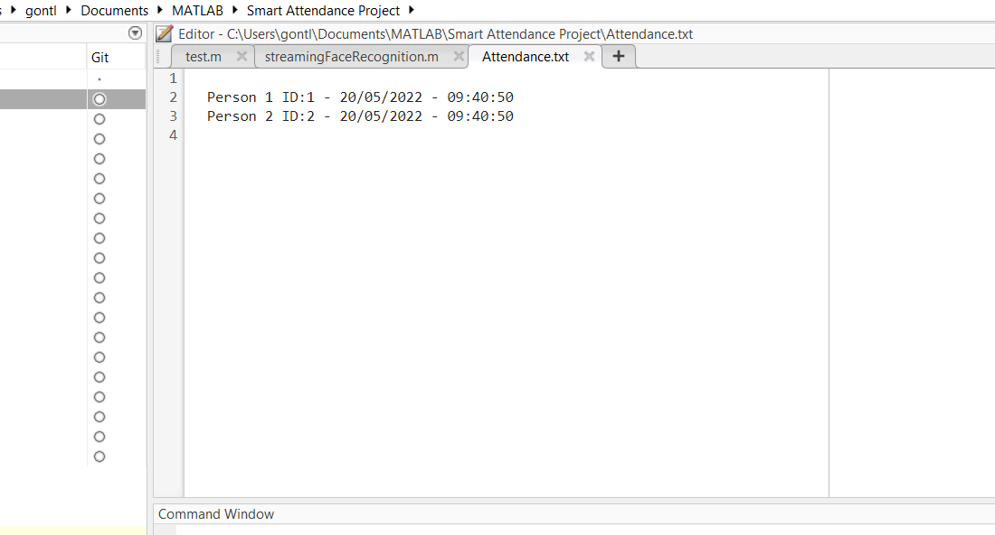
Attendance will be recorded in this way.

Slide 17
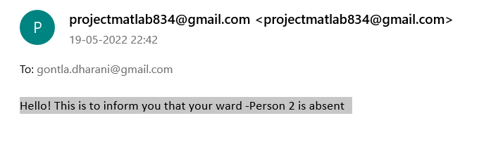
The mail will be send to parents as shown in the below picture.

Slide 18
Limitations and Applications
Limitation:
Can’t take a data of a particular person because matlab won’t support.
Applications:
Can be used for various places such as schools, colleges and etc. for taking attendance.
Airport authorities use facial recognition at security check-ins for international flights.
Facial recognition system has become indispensable in payments, enabling contactless payment methods by scanning an individual’s biometric features.
Facial recognition helps in the patient check-in process, real-time emotion detection, patient tracking, diagnosis of certain diseases or conditions, staff identification and facilities security.

Slide 19
Conclusion and future scope of this project
Future scope of this project:
● Almost all academic institutions require attendance records of students and maintaining attendance manually can be hectic as well as time consuming.
● Hence maintaining attendance automatically with the help of face recognition will be very helpful and less prone to errors as compared to manual process.

Slide 20
Conclusion
With the advent of fast and cheap machines, digital image processing has become a very highly demanded field of study and practice. It provides solutions to various real-life applications in an economical way.
This system can be implemented for better results regarding the management of attendance and leaves. The system will save time, reduce the amount of work the administration has to do and will replace the stationery material with electronic apparatus and reduces the amount of human resource required for the purpose. Hence a system with expected results has been developed but there is still some room for improvement.

Slide 21
References
[1] Muhammad Fuzail, Hafiz Muhammad Fahad Nouman, Muhammad Omer Mushtaq, Binish Raza, Awais Tayyab, and Muhammad Waqas Talib, “Face Detection System for Attendance of Class’ Students”, International Journal Of Multidisciplinary Sciences And Engineering, vol. 5, no. 4, April 2014
[2]Aziza Ahmedi , 2Dr Suvarna Nandyal, “An Automatic Attendance System Using Image processing”, The International Journal Of Engineering And Science (IJES), vol. 4, issue 11 2014.
[3] T Muni Reddy1, V Prasad1, N V Ramanaiah, “Face Recognition Based Attendance Management System By Using Embedded Linux”, IJERST, vol. 4, no, 2, may 2014.
[4] Abhishek Jha, “Class Room Attendance System using Facial Recognition System”, The InternationalJournal of Mathematics, Science, Technology and Management. (ISSN: 2319-8125) Vol. 2 Issue 3, 2016.
[5] Vikram K and S. Padmavathi. “Facial parts detection using Viola Jones algorithm”. Advanced Computing and Communication Systems (ICACCS), 2017 4th International Conference on IEEE, 2017.
[6] Facial recognition system. (2020). Retrieved March 25, 2020, from https://en.wikipedia.org/wiki/Facial_recognition
[7] Arduino Uno. (2020). Retrieved March 25, 2020, from https://en.mwikipedia.org/wiki/Arduino_Uno
[8] MATLAB. (2020). Retrieved April 3, 2020, from https://en.m.wikipedia.org/wiki/MATLAB

Slide 22
References
[09] Li, B. A principal component analysis approach to noise removal for speech denoising. In Proceedings of the 2018 International Conference on Virtual Reality and Intelligent Systems (ICVRIS), Hunan, China, 10–11 August 2018;
[10] Hegde, N.; Preetha, S.; Bhagwat, S. Facial Expression Classifier Using Better Technique: FisherFace Algorithm. In Proceedings of the 2018 International Conference on Advances in Computing, Communications and Informatics (ICACCI), Bangalore, India, 19–22 September 2018;
[11] Weber, M. The Probabilistic Eigenspace Approach. Available online: www.vision.caltech.edu (accessed on 20 July 2020).
[12] Jin, S.; Lin, Y.; Wang, H. Automatic Modulation Recognition of Digital Signals Based on Fisherface. In Proceedings of the 2017 IEEE International Conference on Software Quality, Reliability and Security Companion (QRS-C), Prague, Czech Republic, 25–29 July 2017;
[13] Shen, W.; Wang, W. Node Identification in Wireless Network Based on Convolutional Neural Network. In Proceedings of the 2018 14th International Conference on Computational Intelligence and Security (CIS), Hangzhou, China, 16–19 November 2018;
[14] Shalini, K.; Ravikurnar, A.; Vineetha, R.; Aravinda, R.D.; Anand, K.M.; Soman, K. Sentiment Analysis of Indian Languages using Convolutional Neural Networks. In Proceedings of the 2018 International Conference on Computer Communication and Informatics (ICCCI), Coimbatore, India, 4–6 January 2018;

Slide 23
References
[15] Xiao, Y.; Keung, J. Improving Bug Localization with Character-Level Convolutional Neural Network and Recurrent Neural Network. In Proceedings of the 2018 25th Asia Pacific Software Engineering Conference (APSEC), Nara, Japan, 4–7 December 2018;
[16] Mahajan, N.V.; Deshpande, A.; Satpute, S. Prediction of Fault in Gas Chromatograph using Convolutional Neural Network. In Proceedings of the 2019 3rd International Conference on Trends in Electronics and Informatics (ICOEI), Tirunelveli, India, 23–25 April 2019;
[17] S Amulya,: Pilli Siva Gowtham Reddy,: SA Hariprasad,; MP Sunil,. FACE DETECTION AND RECOGNITION FOR AUTOMATIC ATTENDANCE SYSTEM. International Education and Research Journal, 2018;

Slide 24
Thank you

